Slide 1

Final Project – Predicting Stock Prices* Demystifying ML
Ken Ho & Ronald Rivas
Dec 15, 2020
* This exercise is solely for the purpose of fulfilling an academic assignment

Slide 2
Background & Approach
Using Yahoo Finance historical data, we will predict the stock price of several auto companies by creating several different models using SciKit-learn Machine Learning in Python
Python modules were used for the overall project. Pandas were used here to process the api data and output data were store in SqlLiteDB
Pandas _datareader module was used to fetch the stock data from Yahoo Finance API. Yahoo Finance is free to use (no API key required)
General Motors Company (GM) was used to build the three (3) different predictive models as follows:
Linear Regression
Polynomial Degree 2 with Ridge Regression
Polynomial Degree 2 with Linear Regression
Data set (CSV) used was 2017 to 2020 daily GM stock price data and cleaned with Python Pandas. Used 2010 to 2020 data to create the model but the results were not very predictive due the varying economic conditions over that long period
The Adjusted Closing Price is the dependent (predicted) variable while the independent variables are price data related to Open, Close, High, Low
Used Scikit Learn Module - train_test_split to split data into training data for training the model and test data to check the accuracy of the model. Test data set is 30% of overall dataset.
Autocorrelation analysis and plot were performed comparing General Motors to other auto companies. Plotted with Seaborn
Visualizations of the model results used Plotly

Slide 3
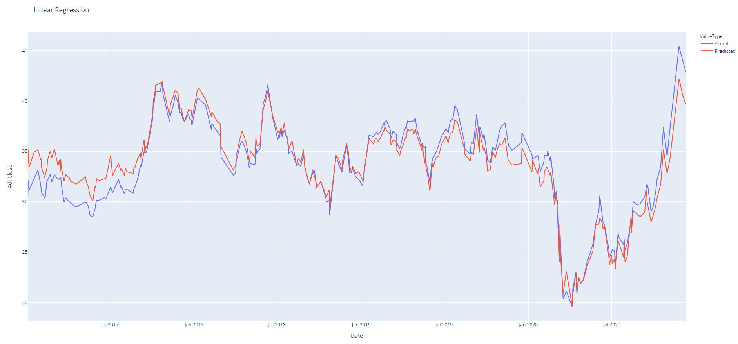
GM linear regression
2017 data due to its age is less predictable

Slide 4
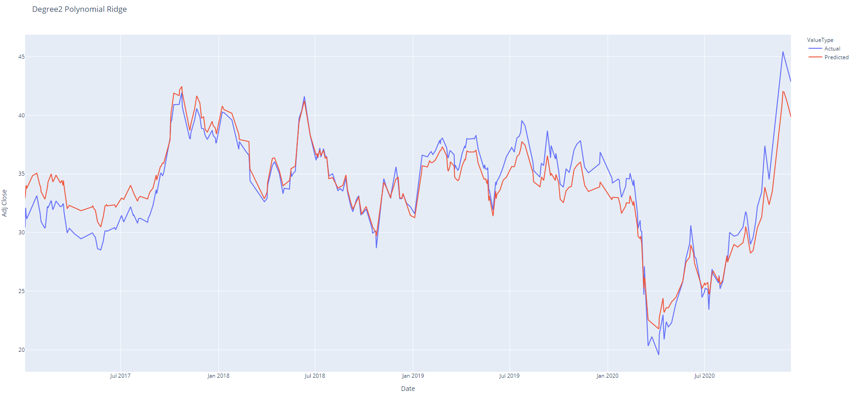
GM degree 2 polynomial ridge regression

Slide 5
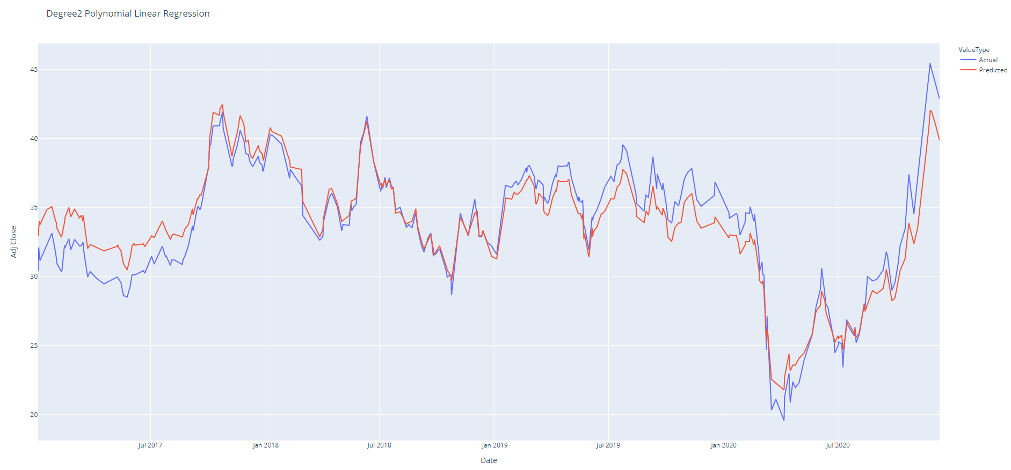
GM degree 2 polynomial linear regression

Slide 6
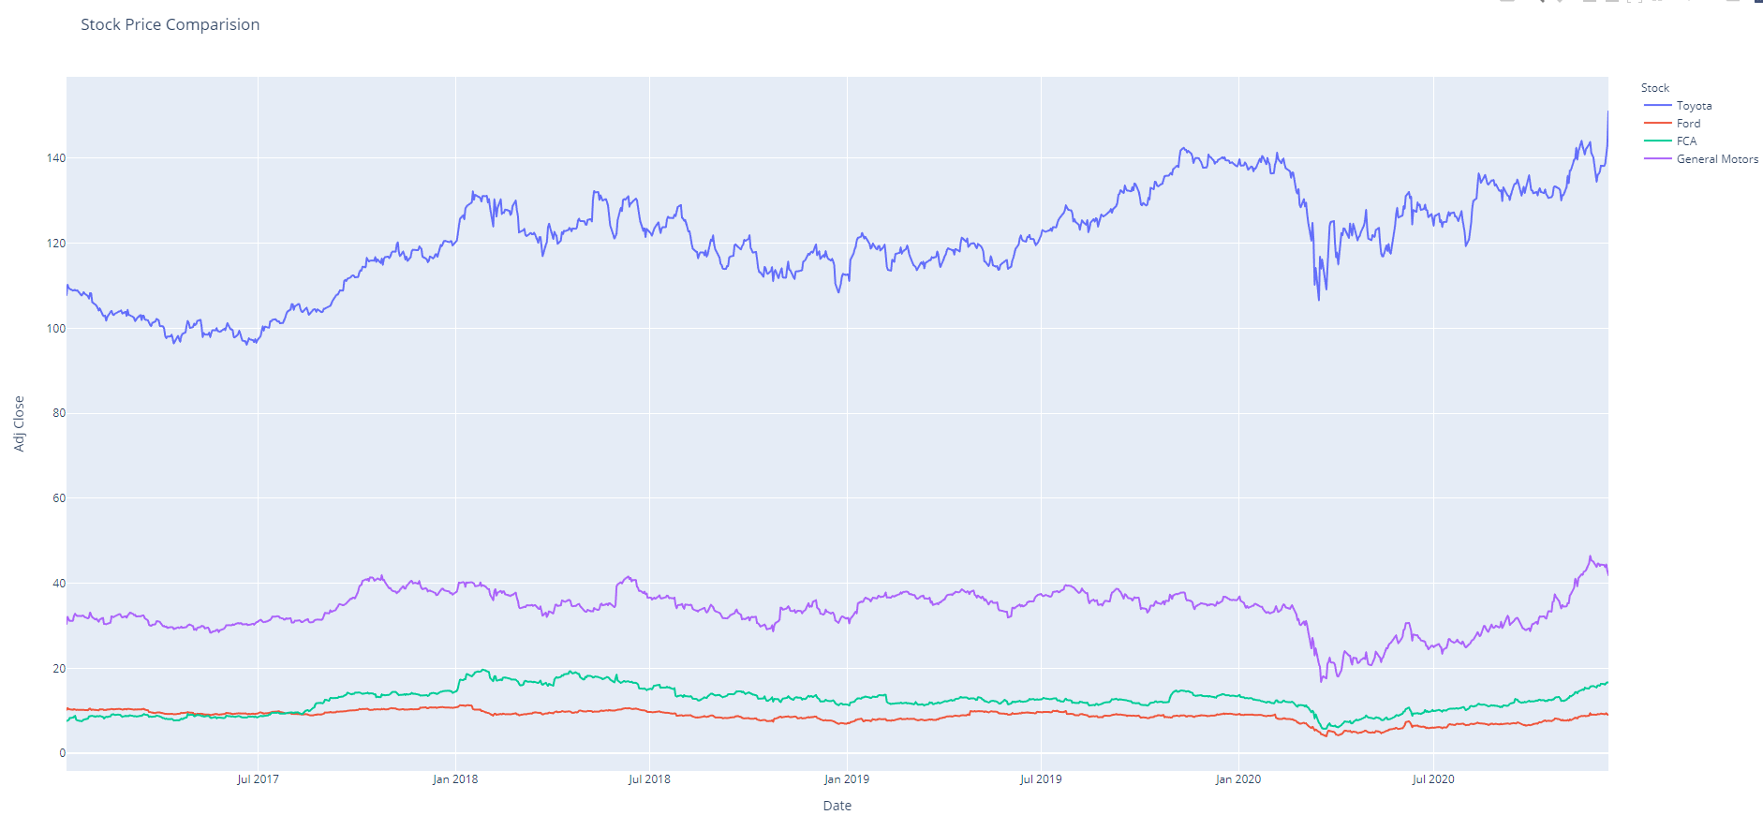
Interactive: auto companies stock price comparison

Slide 7
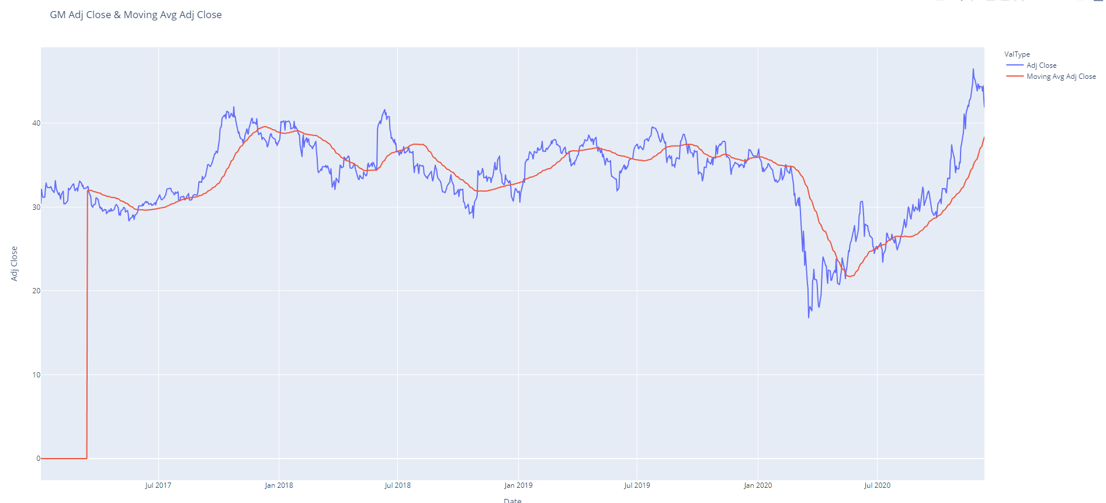

Interactive: GM to show the Adjusted Close and Moving Average (50 day) Adjusted Close
Volatility
Volatility due to COVID-19

Slide 8
Predictive Model Results
All three (3) predictive models’ results are reliable as the Accuracy Scores are 0.91+ and the Mean Squared Error are less than 2.00 (values closer to zero are better)
The Polynomial Degree 2 with Linear Regression model is the best among the three (3)

Slide 9
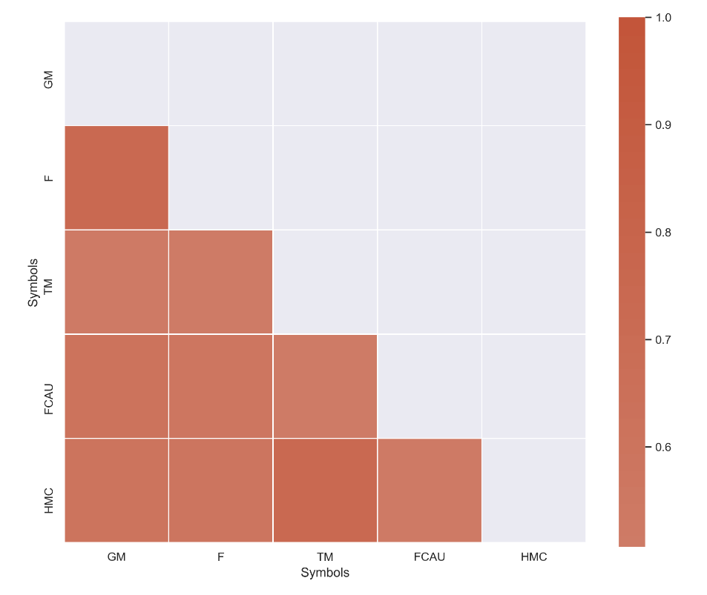
Autocorrelation Results
Ford Motor Company’s stock price is most correlated with General Motors
0.74
Plotted with Seaborn

Slide 10
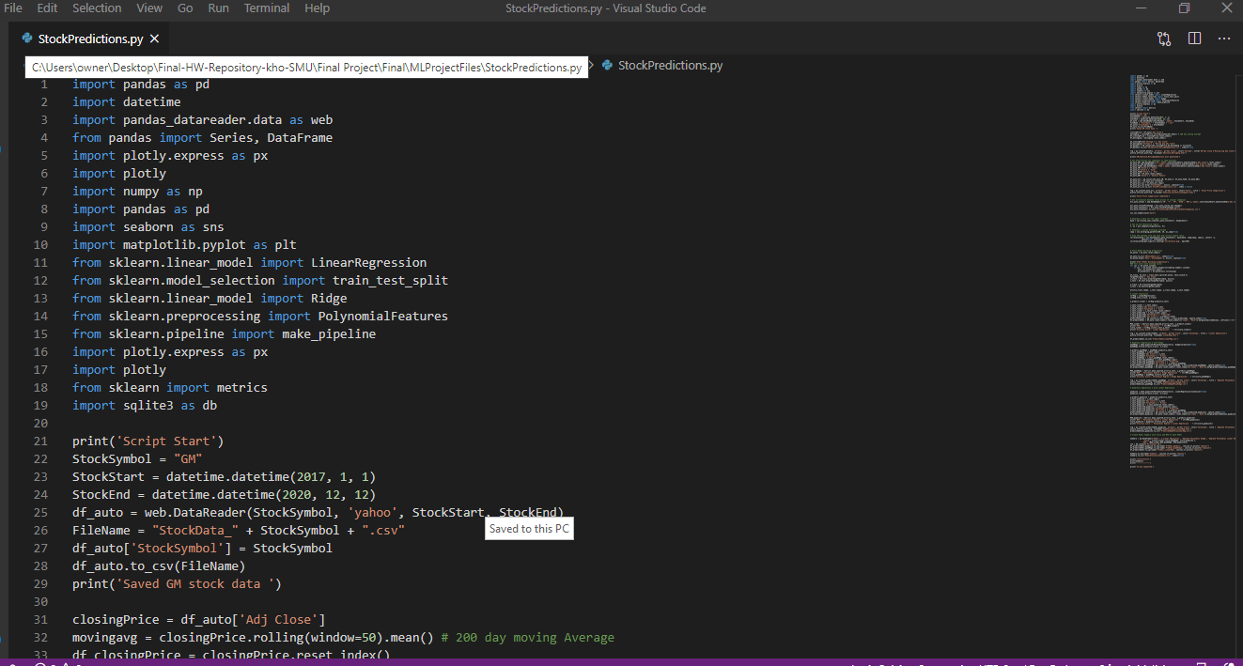
Stock Prediction Code example

Slide 11
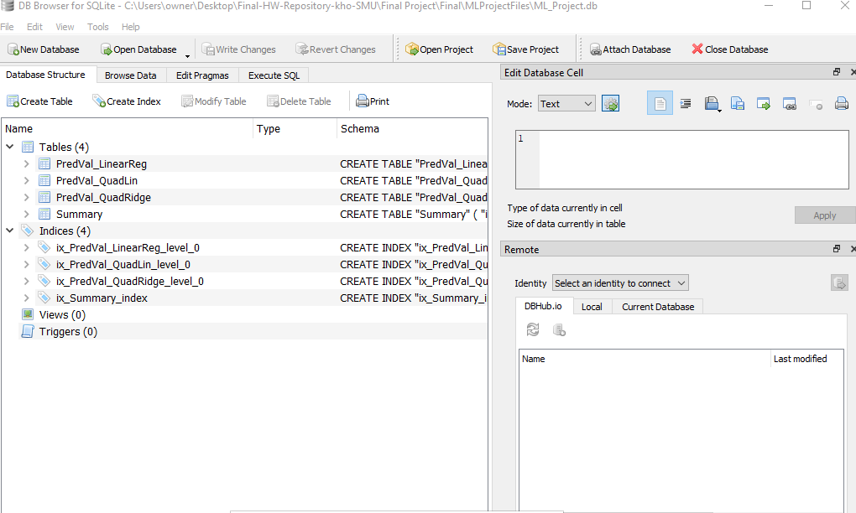
SqlLiteDB

Slide 12
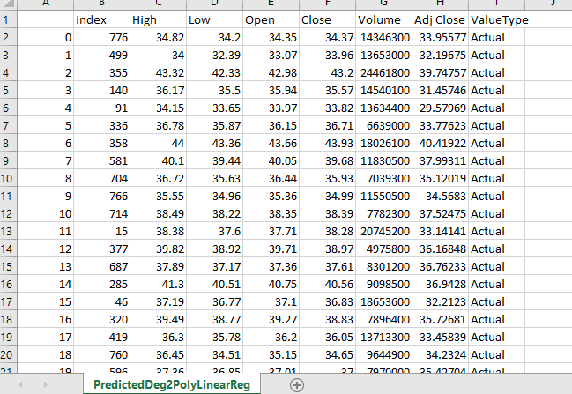
SqlLiteDB Output

Slide 13
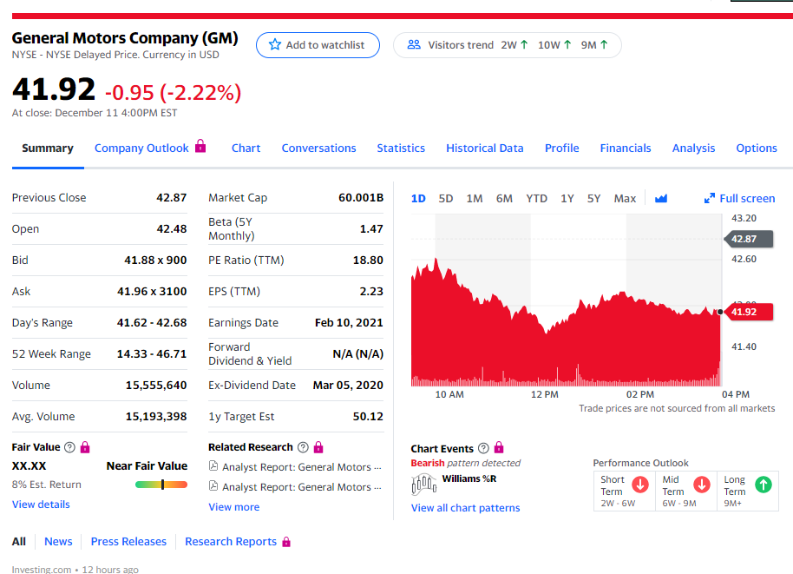
GM Stock Price Page from Yahoo Finance

Slide 14

This API returns raw (as-traded) daily time series (date, daily open, daily high, daily low, daily close, daily volume) of the global equity specified, covering 20+ years of historical data.
By default, output size = compact. Strings compact and full are accepted with the following specifications: compact returns only the latest 100 data points; full returns the full-length time series of 20+ years of historical data.
Symbol is used as the name of the equity chosen. Example: symbol=TSLA
demo

Slide 15
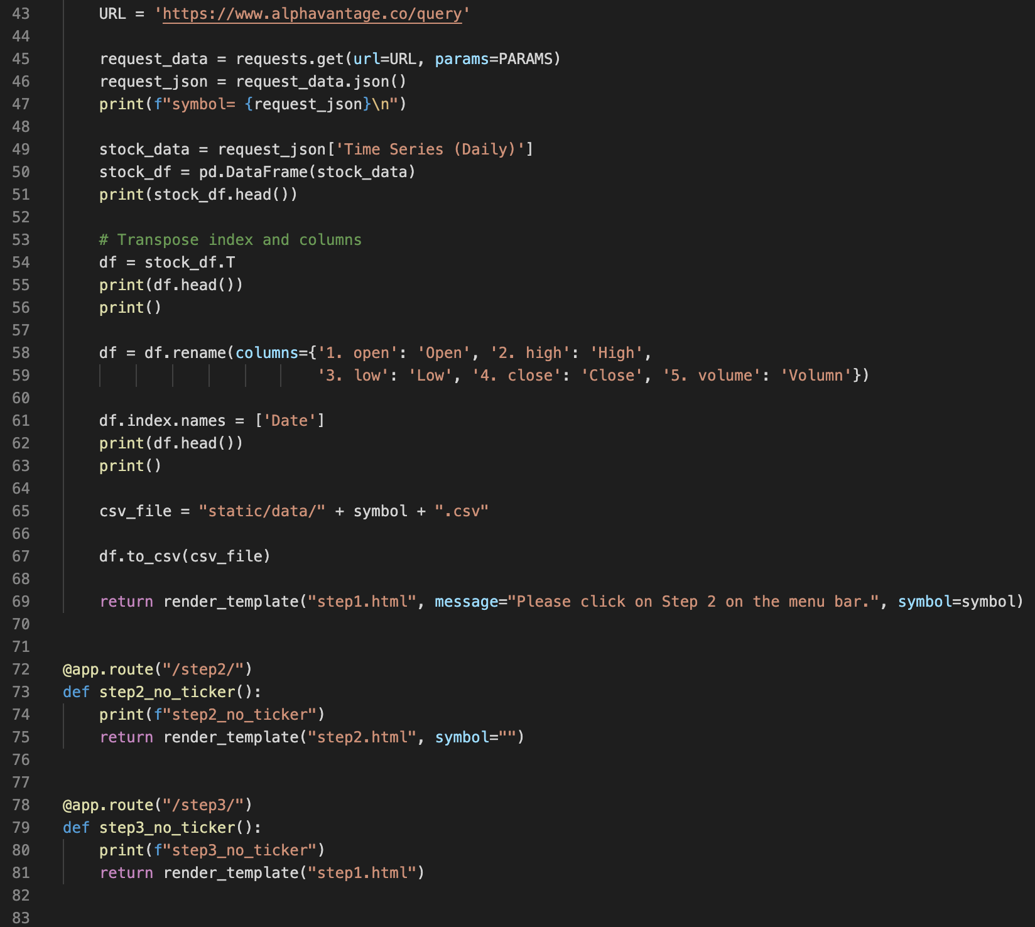
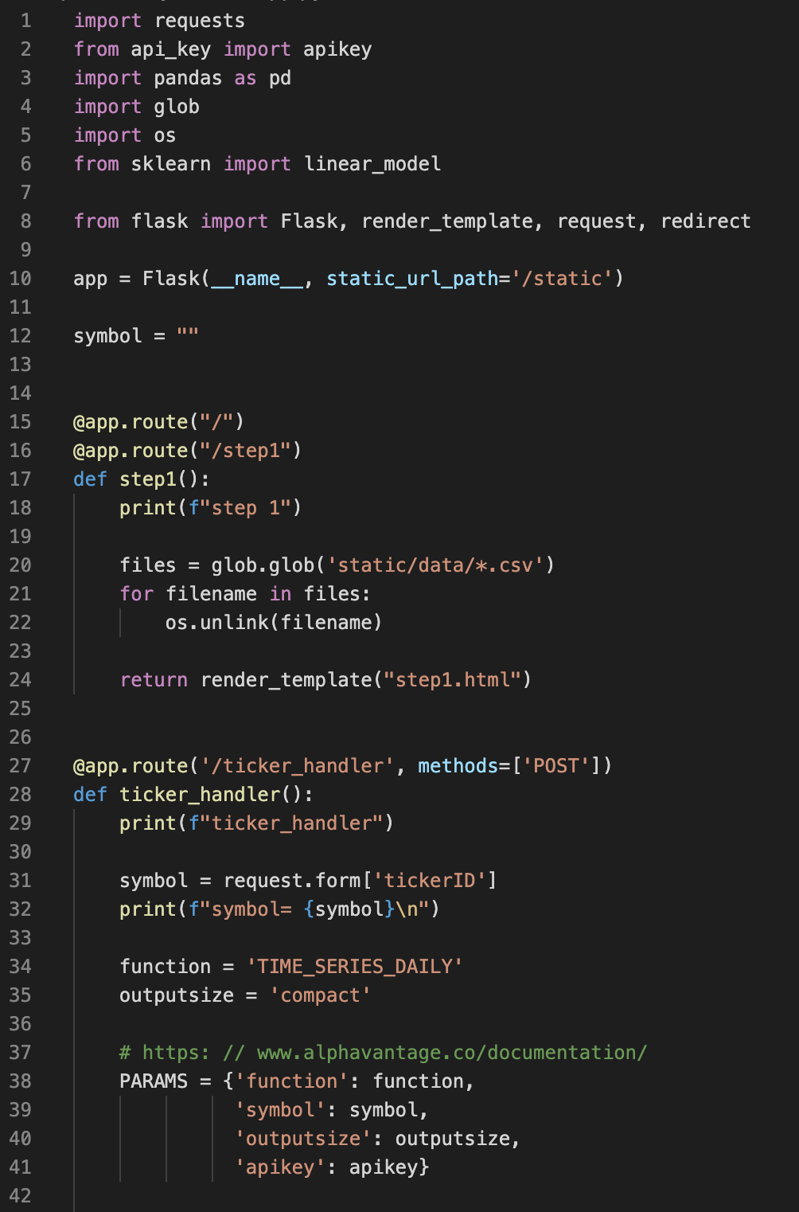
API Code example

Slide 16
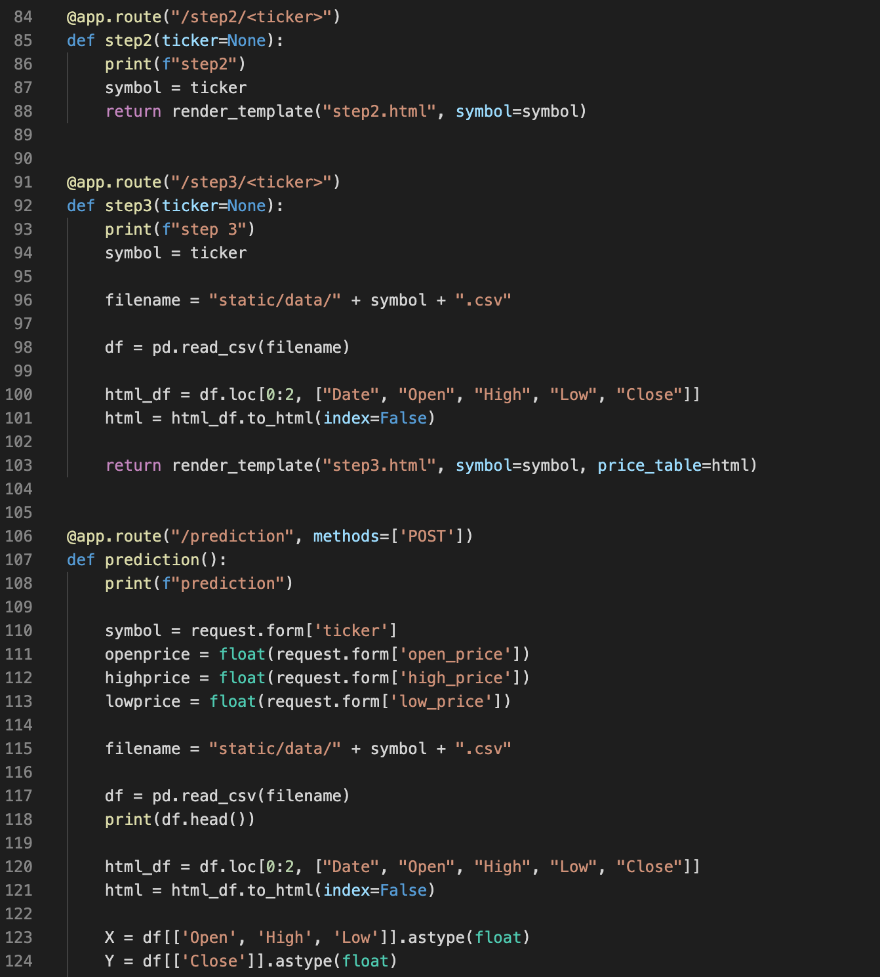
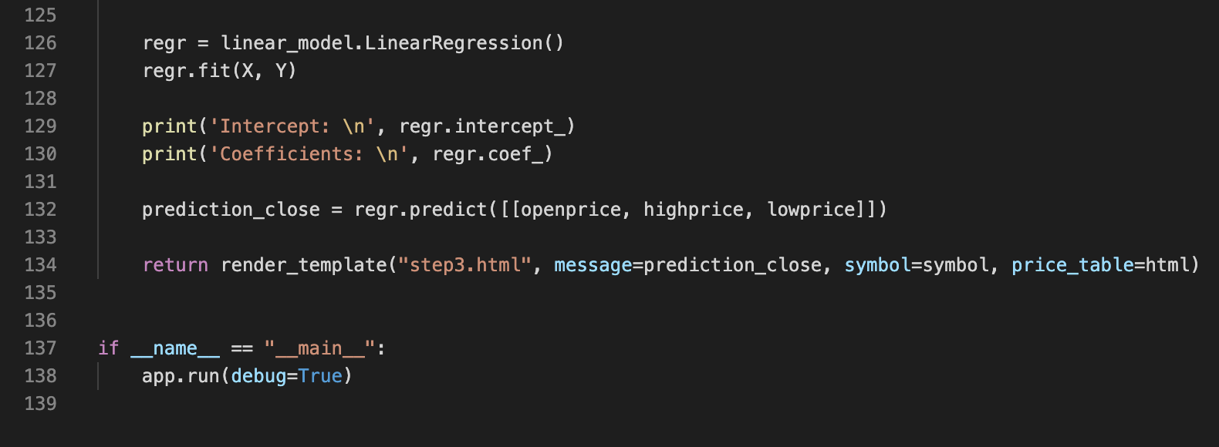
API Code example (cont’d.)

Slide 17
Definitions
The opening price is the price at which a security first trades upon the opening of an exchange on a trading day
The high is the highest price at which a stock traded during a period. The low is the lowest price of the period. A stock's high and low points for the day are often called it's intraday high and low. It is also common to see a stock's 52-week high and 52-week low listed.
Closing price of a stock is the price of that stock at the close of the trading day.
Adjusted closing price is a more complex analysis that uses the closing price as a starting point, but it takes into account factors such as dividends, stock splits and new stock offerings to determine a value
In statistics, the mean squared error (MSE) or mean squared deviation (MSD) of an estimator (of a procedure for estimating an unobserved quantity) measures the average of the squares of the errors—that is, the average squared difference between the estimated values and the actual value. MSE is a risk function, corresponding to the expected value of the squared error loss. The fact that MSE is almost always strictly positive (and not zero) is because of randomness or because the estimator does not account for information that could produce a more accurate estimate. The MSE is a measure of the quality of an estimator—it is always non-negative, and values closer to zero are better.
The r2 score varies between 0 and 100%. It is closely related to the MSE (see below), but not the same. Wikipedia defines r2 as
” …the proportion of the variance in the dependent variable that is predictable from the independent variable(s).”
Another definition is “(total variance explained by model) / total variance.” So if it is 100%, the two variables are perfectly correlated, i.e., with no variance at all. A low value would show a low level of correlation, meaning a regression model that is not valid, but not in all cases.

